Slide 1
Thinking Cards and cognitive distortions Lesson 2 Learning to think accurately

Slide 2
Aim: to introduce helpful thinking as a way to improve wellbeing
Objective 1: to be able to give examples of helpful thinking
Objective 2: to create an accurate thinking plan

Slide 3
Once we know what our inaccurate thoughts are, we can identify facts that challenge those thoughts. We can also use helpful thinking.

Slide 4
For example, if we magnify a problem then we can check the facts and put the problem in perspective.

Slide 5
We can challenge our thoughts with facts.
We can see if a thought is true, or only a belief.
In this way we get a reality check.

Slide 6
There is helpful thinking we can use to improve our wellbeing.
Click here to watch videos about Helpful Thinking

Slide 7
Choose one inaccurate thought from last lesson that you will complete a reality check on.

Slide 8
Links to unhelpful thinking videos
Negative Glasses Stuck in the future
All or Nothing Blame Me
Trash Talk Flooding
Kick/Keep Snowballing
Magnifying Nothing can Change
Mind Reading Jumping to Conclusions
Blocking the Positive Being Wrong

Slide 9
Choose one or more Helpful Thinking Cards from the videos to help you with that unhelpful thought.

Slide 10
Links to helpful thinking videos
Get some Perspective Know your Strengths
Right Here Right Now Positive Memories
Remix/Rewind Never Give Up
False Facts Senses
Talk Yourself up Problem Solving
Change the Channel Grow your Optimism
Breathing Space

Slide 11
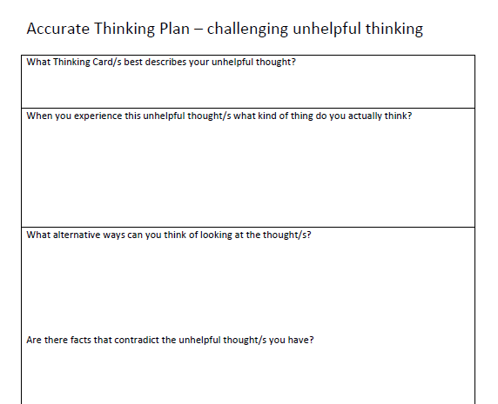
Complete the Accurate Thinking Plan.

